Slide 1
Relationship of Omega-6 Polyunsaturated Fatty Acids and DNA Methylation in the Multi-Ethnic Study of Atherosclerosis
Xizhi Xu
University of Minnesota, Division of Biostatistics
Plan B Project Presentation
Plan B Advisor: Dr. Weihua Guan
June 11, 2024

Slide 2
Background
Inflammation is a key response to infection and injury and is part of the normal, innate immune response. Fatty acids are involved in the inflammatory process on multiple levels.
The existing evidence has shown that fatty acids impact cytokine signaling through global DNA methylation because of roles of individuals in one-carbon metabolism.

Slide 3
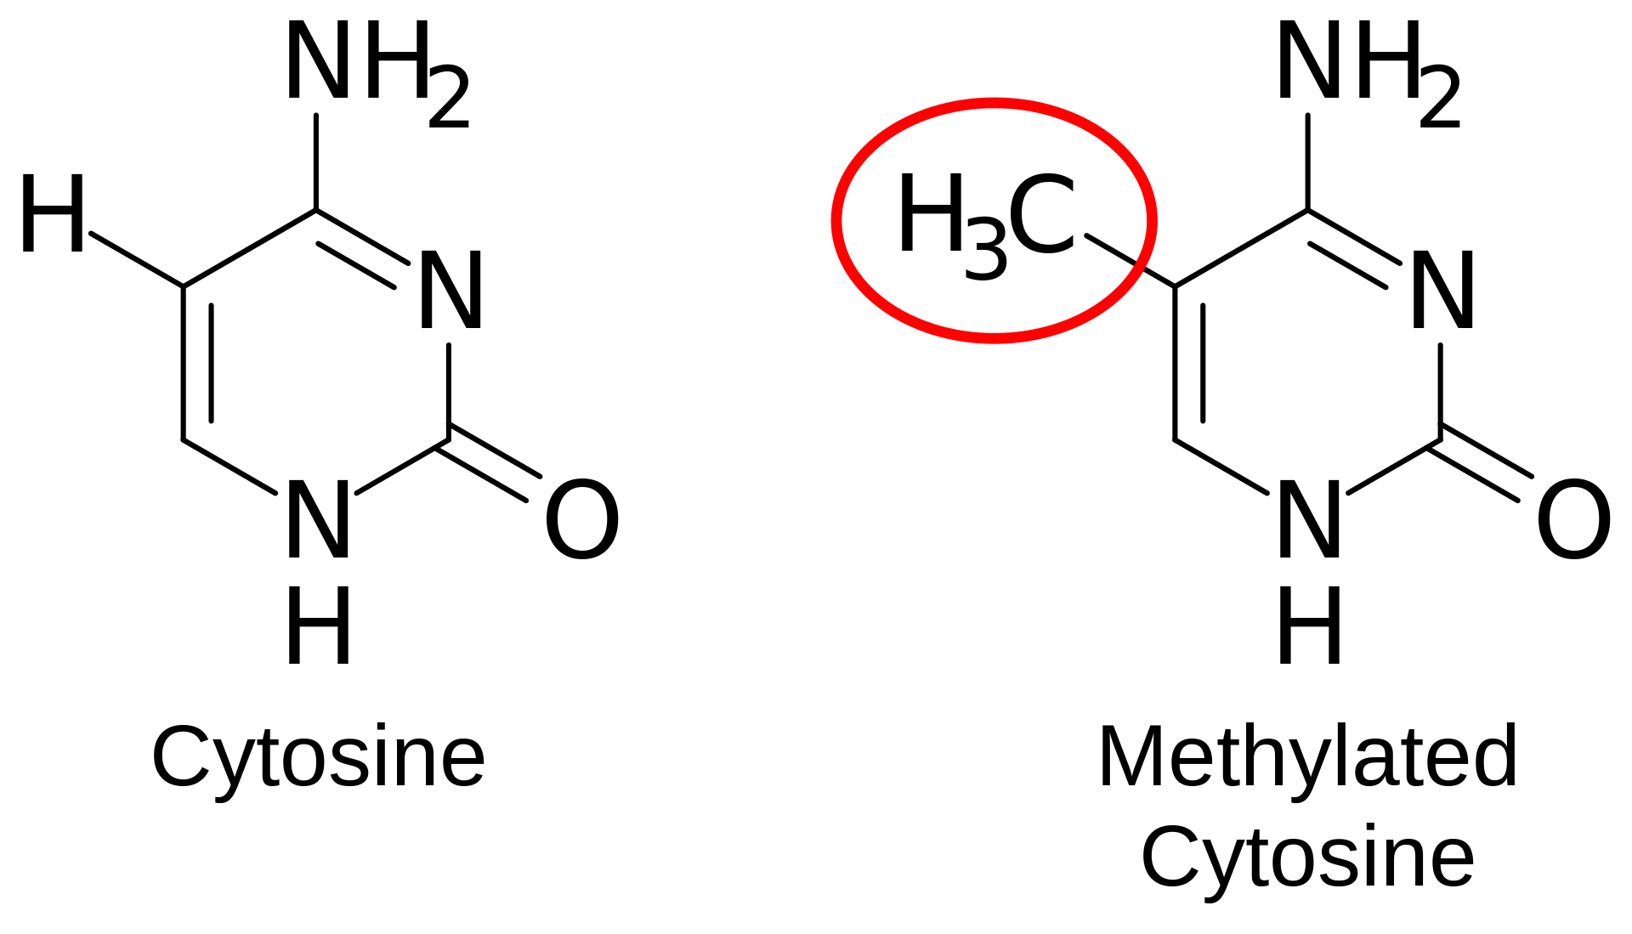
DNA Methylation
What is DNA methylation?
DNA methylation is an epigenetic mechanism where
a methyl group is added to the cytosine or adenine DNA
nucleotides. It typically occurs at CpG sites.
What are the functions of DNA methylation?
Regulate gene expression: E.g. X-chromosome inactivation.
Maintain genomic stability: Suppress the activity of transposable elements.
Notes:
CpG stands for …, X-CHR inactivation, in female mammals… And the DNA methylation can potentially prevent this case.

Slide 4
Research Hypothesis
Omega-6 PUFAs influence methylation patterns of individual several CpG sites of the TNF gene in differing ways depending on individual fatty acid.
Omega-6 PUFAs influence methylation patterns of other genes in similar manner to those in aim 1.
Notes:
TNF genes.

Slide 5
Methods: Data Collection
The current research is mostly based on the analysis of purified monocyte samples of 1264 randomly selected participants from 4 clinical centers.
Originally, included probes for 485K CpG sites. Based on the quality control elimination criteria, where detected methylation levels <90% of MESA samples using a detection P value cutoff of 0.05 or overlap with a repetitive element or region, 484817 CpG sites passed the criteria and remained as the final methylation data.
38 missing observations regarding different covariates in phenotype data. (3%)

Slide 6
Surrogate Variable Analysis (SVA)
Primary variables: explicitly include them in the model.
Unmeasured factors: sources of expression variation that cannot explained by primary variables. (environmental, demographic or technical)
E.g. Consider a human expression study where disease status on a particular cell type is the primary variable.
Goal: identify and estimate the unknown sources of variation in high-dimensional data.

Slide 7
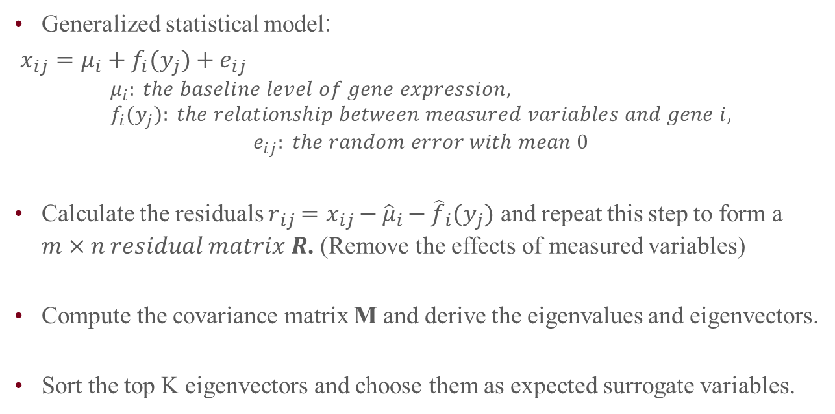
How SVA Works / SVA Algorithm
Generalized statistical model:
$x_{ij}=μ_{i}+f_{i}{(y}_{j})+e_{ij}$
$$μ_{i}: the baseline level of gene expression, f_{i}{(y}_{j}): the relationship between measured variables and gene i,$$
$$e_{ij}: the random error with mean 0$$
Calculate the residuals $r_{ij}=x_{ij}−{\hat{μ}}_{i}−{\hat{f}}_{i}(y_{j})$ and repeat this step to form a $m×n residual matrix R$. (Remove the effects of measured variables)
Compute the covariance matrix M and derive the eigenvalues and eigenvectors.
Sort the top K eigenvectors and choose them as expected surrogate variables.
Notes:
How to decide K?

Slide 8
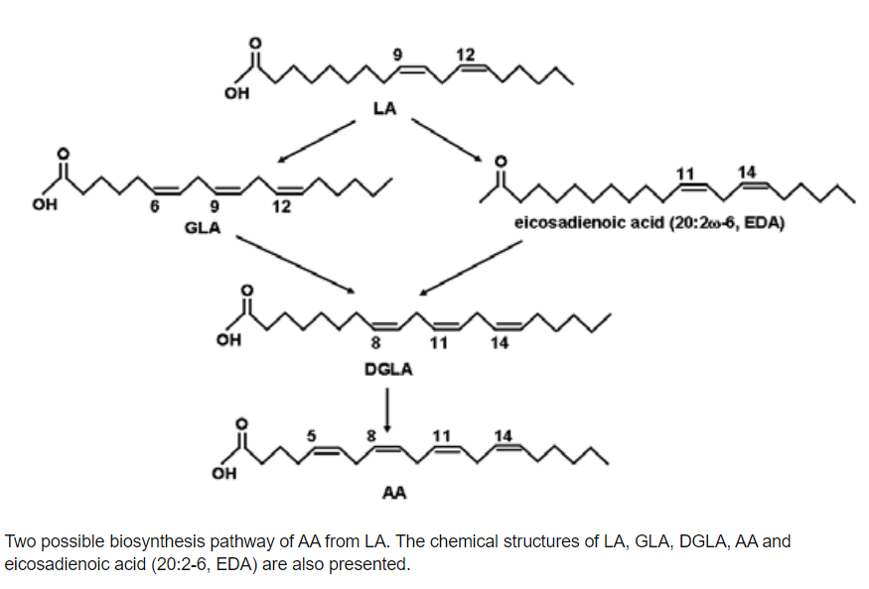
Model Specification
Linear regression.
Outcome: DNA methylation CpG sites.
Exposure variables: linoleic acid (LA), eicosadienoic acid (EDA),
gamma-linolenic acid (GLA), dihommo-gamma-linolenic acid (DGLA),
arachidonic acid (AA).
Covariates: age, sex, race, BMI, etc. Surrogate variables are included.
Notes:
3 Bullet: Linear regression
Outcome: DNA methylation
Add a plot (relationship between FA)

Slide 9
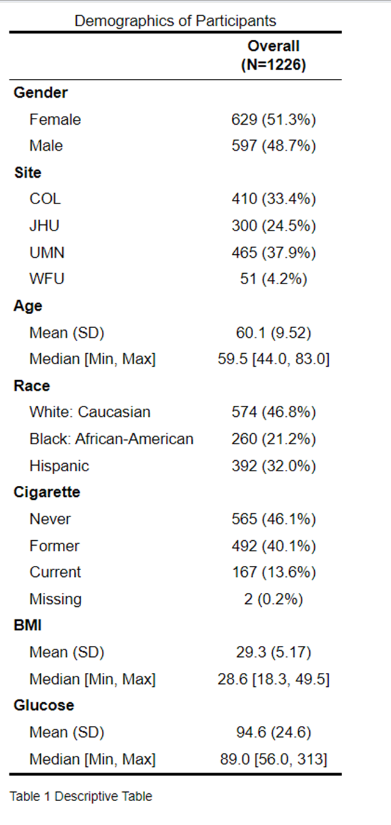
Results: Table 1 Descriptive Table
7 covariates in total: 4 categorical, 3 quantitative
Categorical: proportion and percentage.
Quantitative: mean, median and standard deviation.

Slide 10
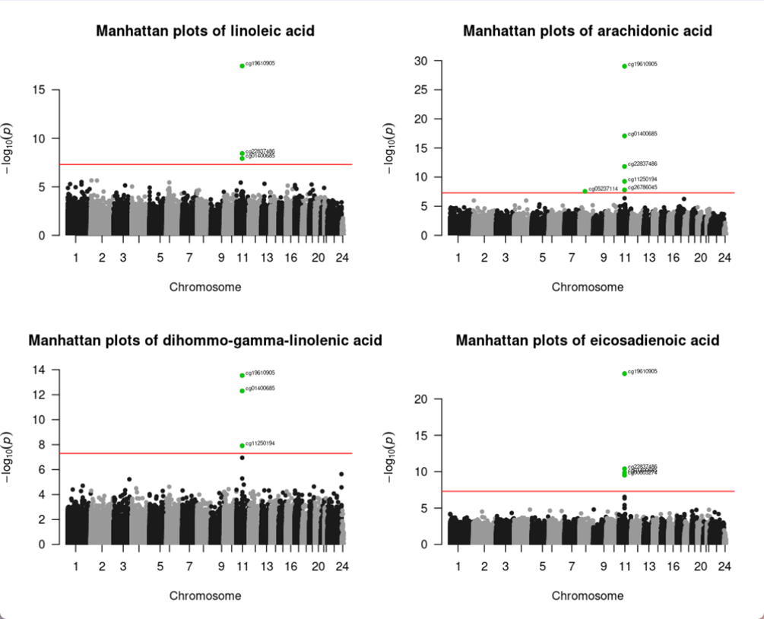
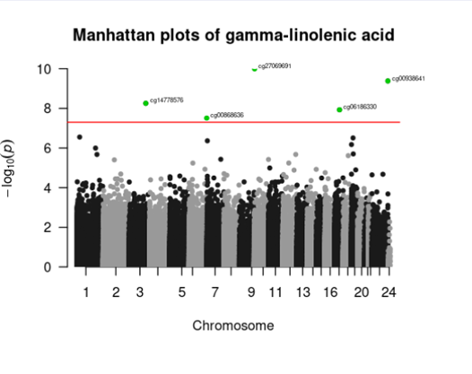
Manhattan Plots (Overview)
Notes:
X-axis, Y-axis, red line, Bonferroni, top CpG.

Slide 11
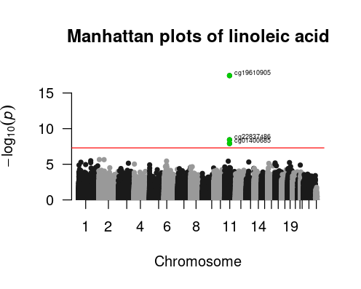
Manhattan Plot: LA
Top CpG: cg19610905
with p-value 3.865e-28
Reference gene: FADS2
(Fatty Acid Desaturase 2),
protein coding gene
Notes:
Protein coding gene, detailed gene information and functions will be talked about in Discussion. The 2 other significant CpG sites will be marked and added to supplemental table, conclusion

Slide 12
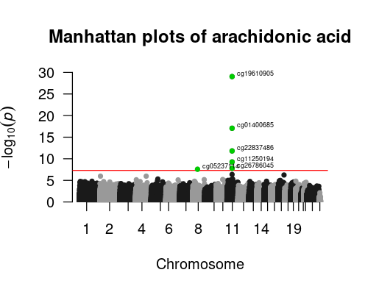
Manhattan Plot: AA
Top CpG: cg19610905
with p-value 9.38e-30
Replicated CpG: cg01400685,
cg22837486.
Additional gene region: RAB3IL1,
encodes a guanine nucleotide
exchange factor.
Notes:
Cg..6045

Slide 13
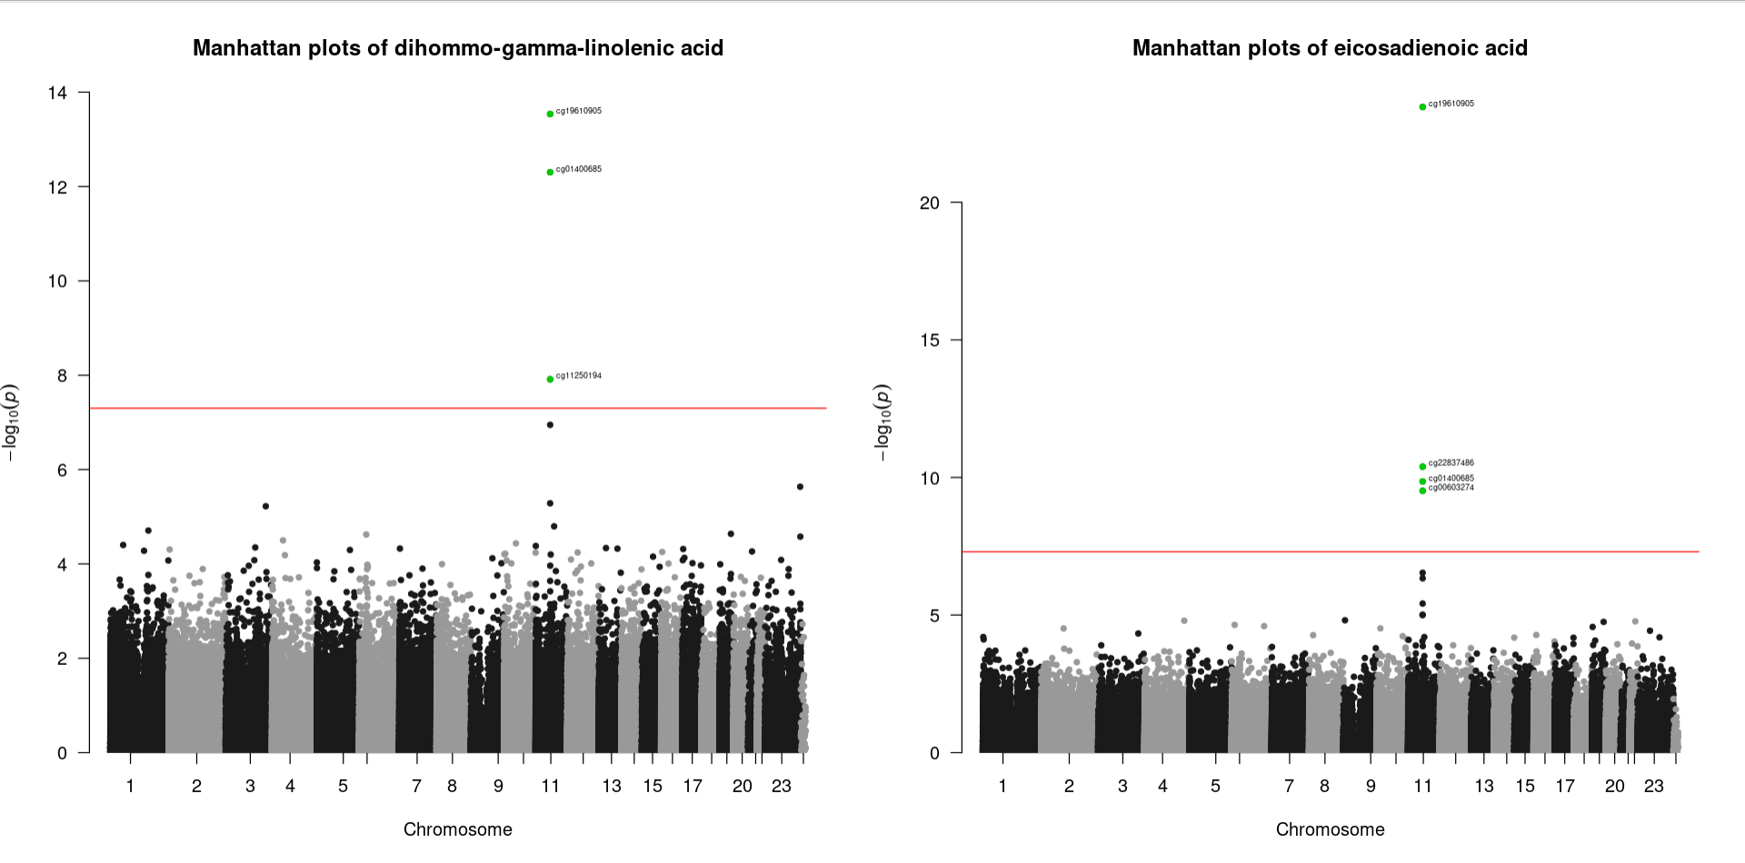
Manhattan Plots: DGLA / EDA
Notes:
For the next 2 FAs, …

Slide 14
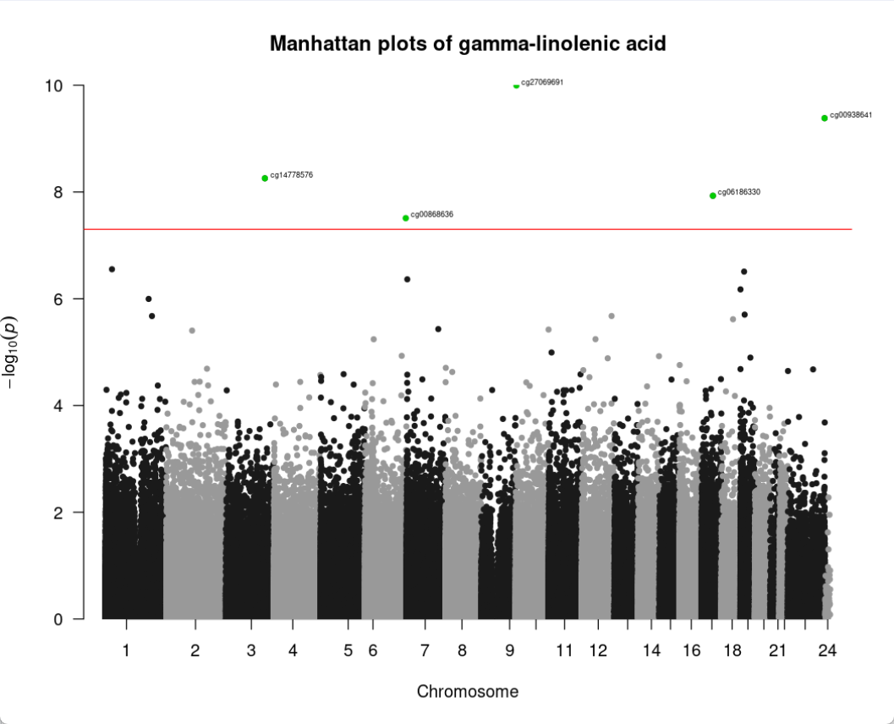
Manhattan Plot: GLA
All significant CpG are new: spread
to chr 6, 23 , 17, 3 ,10.
Additional consideration: confounding SNPs.
Top CpG: cg27069691 with
P-value 1.01e-10. However, nearby SNP: rs72778561.

Slide 15
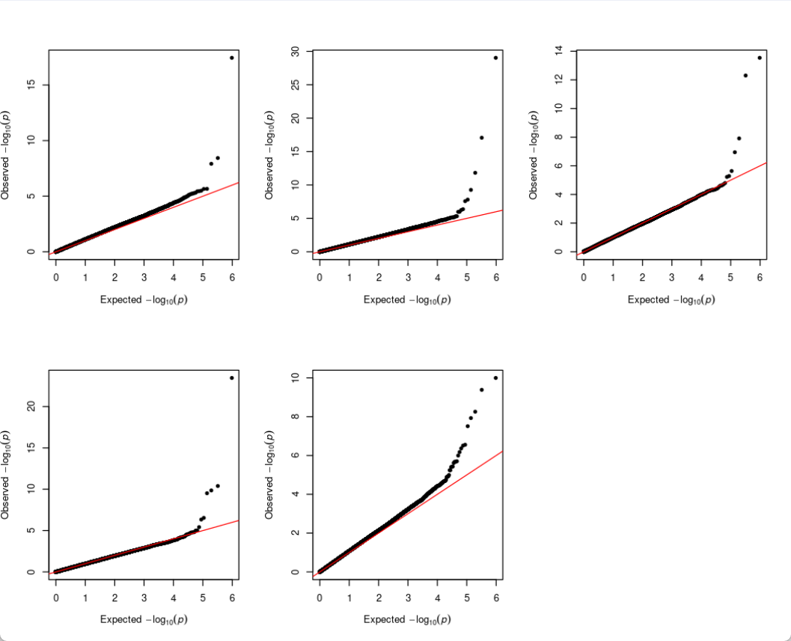
QQ-plots
Red line: expected line.
No evidence for inflation.

Slide 16
Discussion: Summary
Some CpG sites were significantly associated with multiple fatty acids.
Biological mechanisms: metabolic pathways
E.g. cg19610605 reference gene is FADS2, encodes an enzyme involved in the desaturation process of fatty acids.
LA, AA, and EDA are all substrates or products in the same metabolic pathway, they can influence the activity and regulation of the FADS2 gene.
For the first four fatty acids, the significant CpG are all in chromosome 11.
Gene clustering: Chromosome 11 contains a cluster of genes involved in lipid metabolism.
Shared regulatory elements: Chromosome 11 may have shared enhancers, promoters, or other regulatory elements that respond to fatty acid levels.
Notes:
Summing up the previous findings, …

Slide 17
Discussion: Summary
Exception: GLA. Significant CpG spread to 5 different chromosomes.
Gene region: PLXNB3,the protein encoded by this gene is a member of the plexin family. It plays a role as a receptor for semaphorin 5A, and functions in axon guidance, invasive growth and cell migration.
No significant CpG sites found at TNF gene (Hypothesis 1).
Notes:
…I mean I was trying to figure it why but I can’t get the conclusion so far… For the conclusion, if we trace back to research question, the original gene we’re interested …Also, we identified the related genes, realizing the gene functions and potential biological applications.

Slide 18
Limitation / Future Work
Some of the methylation measurements on the array may be confounded by proximity to SNPs, and cross-hybridisation to other areas of the genome.
DMR analysis: efficiently filter the probes based on the distance to target SNPs and the minor allele frequency.

Slide 19
Acknowledgement
Committee members: Dr. Weihua Guan, Dr. Lin Zhang, Dr. Weihong Tang.
Source of data and information: Multi-Ethnic Study of Atherosclerosis (MESA).

